Slide 1
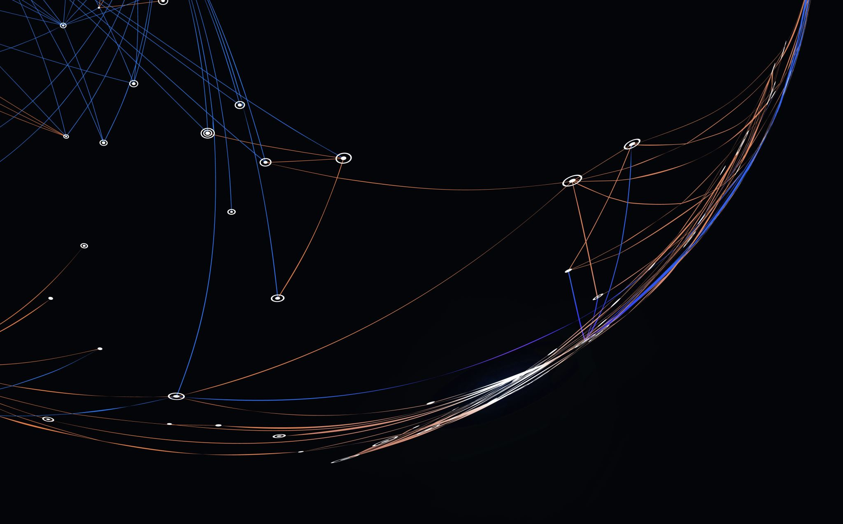
Customer Churn Prediction
Group Members -
Pavani Ravirala – 21203863
Shasank Pyate - 21200341

Slide 2
REFERENCES :
https://downloads.hindawi.com/journals/ddns/2021/7160527.pdf
https://ieeexplore.ieee.org/abstract/document/9544785

Slide 3
Abstract :-
The field of telecommunication faces complex challenges due to a number of vibrant competitive service providers.
It has become very difficult for them to retain existing customers. Since the cost of acquiring new customers is much higher than the cost of retaining the existing customers.
telecom industries to take the necessary steps to retain the customers to stabilize their market value.
In the current decade, several techniques have been proposed in the literature for predicting churners using heterogeneous customer records.
Here in this project one or two such methods were implemented to predict the Customer Churn.

Slide 4
Introduction
Digitalization has led to new ways of doing business and companies across the world are being forced to adapt to this.
During the COVID - 19 pandemic, subscription-based businesses grew significantly and consumers have a wide variety of options to choose from. This is a challenge for companies as retaining customers can be difficult.
We have abundant information about the customers collected over the years. Therefore, it is necessary to automatically extract valuable information from this data.
This has led to the growth machine learning techniques because of their ability to handle large data and gain insights into them.
Enterprises use different data analysis techniques to find customer pattern behavior while purchasing a product to patterns related to customer churning. In a subscription-based business, the key part of success is to minimize the rate of customers ending their subscriptions

Slide 5
WHAT IS CUSTOMER CHURN?
Customer churn or customer attrition is the act where customers chose to end their subscription to a service provider.
Businesses across the globe have recognized that customer churn is a huge loss because they spend a large sum of money on attracting customers.
Customer churn can happen for various reasons and the reasons might differ from one customer to the other.
To retain customers, firms invest in customer churn prediction where they try to predict which of the customers will churn so that they can apply preventive measures.
The preventive measures to be applied depending on the reason a customer might churn. Some examples of preventive measures could be offering discounts or including an extra service

Slide 6
PURPOSE
Helps companies understand the customer purchase pattern and whether they are providing a satisfying service.
Companies can save money by retaining existing customers rather than investing in new customers.
Churn Analysis helps a company to understand why customers don't return back for repeated business or why they return for repeated business.
Companies would get to know what portion of customers leave over a period of time and helps in customer retention.
Helps in developing new strategies over the due course of time and helps to optimize the company's products and services.

Slide 7
HOW TO PREDICT CHURN?
Telecom Companies collect an enormous amount of customer details based on each customer experience ex. When a customer subscribes to a service or when a customer buys a new product etc., these details would include the below details
Customer Care Service Details
Customer Personal Details
Customer Credit Score
Bill and Payment Details
Customer Usage Pattern
Customer Value-added Services and Many more ………….
All the above details are grouped together to form a Dataset and on the same, one of the many different methods to perform Customer Churn Prediction like Churn Prediction based on Decision Trees, Logistic Regression, Artificial Neural Networks and Many others are applied, and Prediction is performed to get a particular customer would churn or do not churn.

Slide 8
CHURN RATE :
(Number of Lost Customers or Cancelled Customers)
Total Number of Customers

